Slide 1



Hive Data Warehouse
Apache
COMP251
Group 3

Slide 2
Group 3
Bernice Meghan Chinthamalla (301284811)
Erick Torres (301250235)
Matheus Vinicius Ferreira Figueiredo Teixeira (301236904)
Tessa Mathew (301296178)
Thejus Shaji (301301078)
Arunima Jagalpriyakumari (301274653)

Slide 3
Agenda
Introduction
Overall Architecture
Key Components
Cloud/On-premise (Hybrid) Capabilities
ELT/ETL and Data Transformation Capabilities
Security Options
Key Competitors
Pricing Structure
Conclusion

Slide 4
INTRODUCTION
Apache Hive Overview:
Data warehouse & ETL tool with SQL-like interface for Hadoop (HDFS)
Integrates seamlessly with Hadoop for distributed storage and processing
Uses HiveQL for querying petabytes of data
Translates SQL queries into MapReduce, Tez, or Spark jobs
Components & Capabilities:
Architecture: Metastore, Execution Engine, HiveQL
ETL/ELT support for data transformation
Security: Authentication, authorization, and encryption
Competitors: Google BigQuery, Amazon Redshift, Snowflake
Flexible deployment: Cloud, on-premise, or hybrid
Key Features of Apache Hive:
Fast: Built for massive dataset batch processing
Familiar: SQL-like interface reduces the learning curve
Scalable: Handles large data volumes and grows with organizational needs

Slide 5
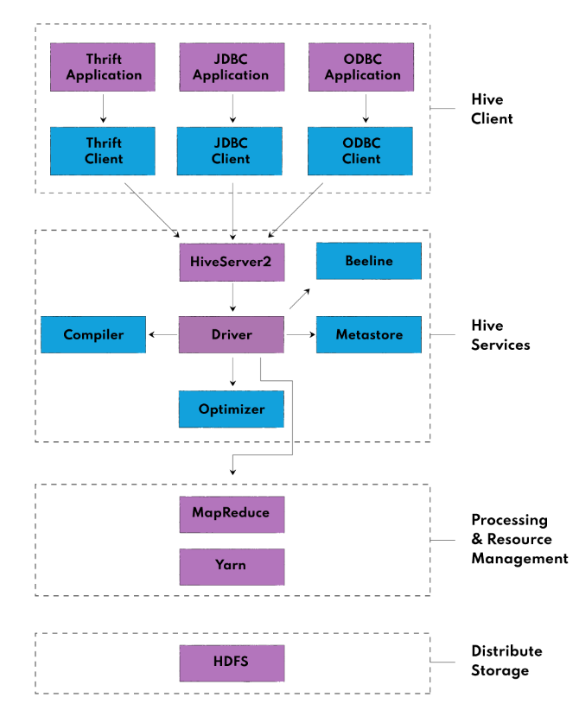
Architecture
There are 4 main blocks, each one with their own components and their key technologies such as:
HDFS
HQL
HiveServer2
Beeline Shell
Hive Metastore

Slide 6
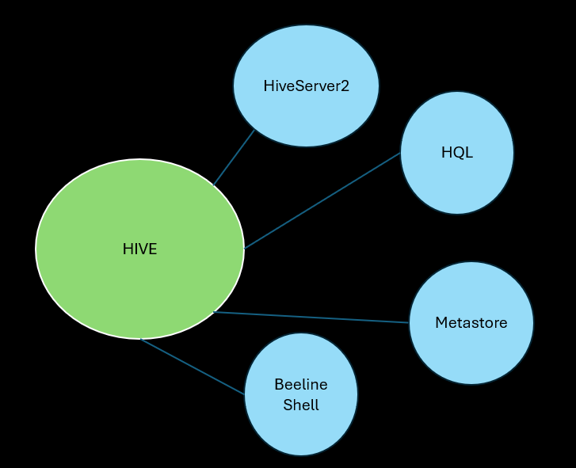
Key Components
HiveServer2: is a service that allows clients to submit Hive queries and retrieve results. It acts as a central gateway for query execution
Hive Query Language :HQL is a SQL-like language designed for querying and managing data in Hive. HQL abstracts the complexities of MapReduce programming
Hive Metastore: is the central repository for storing metadata, including table definitions, schemas, and partition details. It plays a crucial role in enabling Hive to manage and optimize queries by providing necessary schema information
Hive Beeline Shell: is a command-line shell used to interact with HiveServer2. Beeline is the preferred CLI for Hive due to its enhanced functionality and secure integration with HiveServer2

Slide 7
Cloud/On-premise (Hybrid) capabilities
Cloud Capabilities
> Scalability: Easily adapts to workload demands.
> Managed Services: Cloud providers offer streamlined setup and maintenance (e.g., AWS EMR, Azure HDInsight).
> Cost-Effective: Pay-as-you-go model for compute and storage resources.
On-Premise Capabilities
> Data Security: Total control over data and hardware, ideal for sensitive information.
> Customization: Tailored infrastructure to meet specific organizational needs.
> Legacy Integration: Seamless integration with existing on-premise systems.
Hybrid Capabilities
> Data Flexibility: Secure data stays on-premise, with cloud handling scalable processing.
> Cost Flexibility: Optimized costs, using cloud resources for peak processing needs.
> Disaster Recovery: Cloud for backups, enabling business continuity.

Slide 8
ELT/ETL and Data Transformation Capabilities
Manages ETL/ELT processes for structured, semi-structured, and unstructured data
Schema Flexibility: Processes diverse data types with schema-on-read
Wide Input Formats: Extracts data from relational databases, flat files, HDFS, and NoSQL databases
Capabilities
Standard Functions
User-Defined Functions (UDFs)
Window Functions
Complex Data Types
Limitations
May have slower performance compared to specialized ETL tools for certain operations
Complex transformations might require multiple steps or custom UDFs
Lacks native support for real-time or streaming transformations (requires tools like Apache Spark or Flink)

Slide 9
Security Options
Partial masking of sensitive data (since Hive 2.1.0)
Authentication
Metastore
Kerberos
HiveServer2
Kerberos, LDAP, PAM, and Custom Authentication
Authorization Modes
Legacy ModeBasic
permissions, limited security
Storage-Based Mode
Uses HDFS permissions (POSIX, ACLs)
SQL Standard-Based Mode
Fine-grained control with GRANT/REVOKE statements
Data Masking & Encryption
Hashing Functions
md5, sha1, sha2 to secure data
Masking Functions
Uses HDFS permissions (POSIX, ACLs)
Encryption Functions
aes_encrypt, aes_decrypt for data protection
Additional Tools
Apache Sentry, Apache Ranger for advanced authorization
HDFS Encryption for securing data at rest

Slide 10
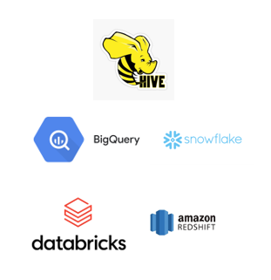
Key Competitors
Google BigQuery: A fully managed, serverless data warehouse optimized for real-time analytics, offering superior performance and scalability compared to Apache Hive, which is better for batch processing.
Amazon Redshift: Uses MPP architecture with columnar storage for fast queries, better for structured data and scalability, while Hive remains cost-effective for batch jobs.
Snowflake: Cloud-based platform with elastic scaling and real-time analytics, outpacing Hive in ease of use and performance, but Hive is more cost-efficient in Hadoop setups.
Databricks Lakehouse: Combines data lakes and warehouses for real-time analytics and machine learning, superior to Hive in advanced analytics, though Hive is better for batch processing.

Slide 11
Pricing Structure
Open-Source Benefits: No licensing fees, customizable, community-driven support
On-Premise Costs: Hardware, operational (power/cooling), and skilled personnel
Cloud Deployment Costs: Compute, storage, and data transfer fees
Hybrid Deployment Costs: Integration costs between on-premise and cloud, offers flexibility
Personnel & Training: Requires skilled IT staff, investment in training for optimal performance
Comparative Cost Analysis: Cheaper than proprietary tools, but consider total cost of ownership (TCO)

Slide 12
Conclusion
Role in Big Data: Bridges traditional databases and modern distributed processing
Scalability: Handles large-scale batch processing with Hadoop integration
Flexible Deployment: Supports on-premise, cloud, and hybrid models
ETL/ELT Capabilities: Robust data transformation and integration
Cost-Efficient: Open-source nature reduces costs
Challenges: Competitors like BigQuery, Redshift, and Snowflake offer real-time analytics and ease of use
Key Strength: Ideal for batch-oriented, large-scale data analytics

